Slide 1



Normalization part 1
Sistem Basis Data
Rizka Wakhidatus Sholikah

Slide 2



Outline
Introduction in normalization
The need of normalization
How to perform normalization
www.its.ac.id
INSTITUT TEKNOLOGI SEPULUH NOPEMBER, Surabaya - Indonesia

Slide 3
Normalization
Normalization is a process for evaluating and correcting table structure to minimize and eliminate redundancies
Normalization works through stages called Normal Forms (NF)
1NF
2NF
3NF
4NF
www.its.ac.id
INSTITUT TEKNOLOGI SEPULUH NOPEMBER, Surabaya - Indonesia

Slide 4
Normalization
Note: you should not assume that the highest level of normalization is always the most desirable
The higher the norm form → the more relational join operation → more resource to respond user queries
Remember that a successful design must also considered end-user demand for fast respond
www.its.ac.id
INSTITUT TEKNOLOGI SEPULUH NOPEMBER, Surabaya - Indonesia

Slide 5
The need of normalization
Normalization can be done when designing database from scratch or modified existing one
The process is the same
The main goal of normalization:
Eliminate data anomalies by eliminating unnecessary or unwanted data redundancies
www.its.ac.id
INSTITUT TEKNOLOGI SEPULUH NOPEMBER, Surabaya - Indonesia

Slide 6
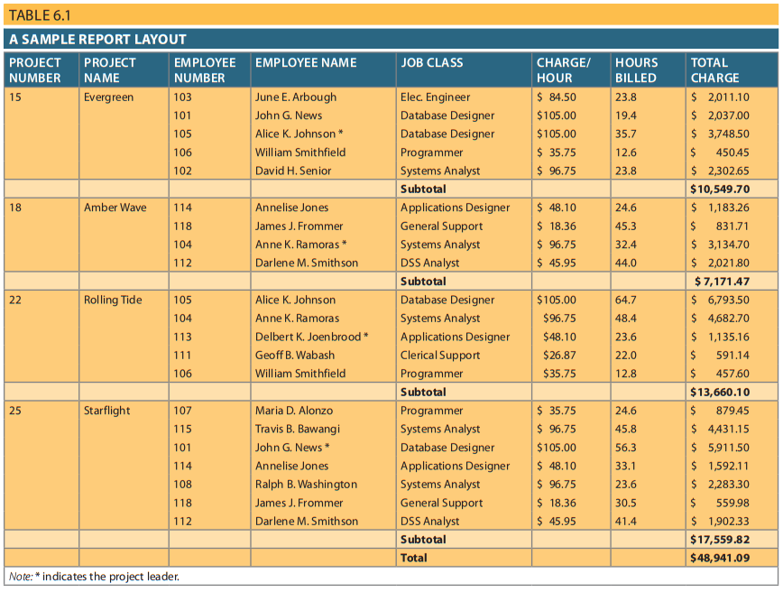
Example
www.its.ac.id
INSTITUT TEKNOLOGI SEPULUH NOPEMBER, Surabaya - Indonesia

Slide 7
Example
From the example, can you give an example of problem that will occur if the table is applied to a table in database
www.its.ac.id
INSTITUT TEKNOLOGI SEPULUH NOPEMBER, Surabaya - Indonesia

Slide 8
Normalization process
Remember of the goal of normalization, the tables must have the following characteristics:
Each table represent single subject
Each cell (the intersection between row and column) only have one value not a group of values
No data item will be stored in more than one table
All nonprime attribute in a table are dependent on the primary key
Each table has no insertion, update, or deletion anomalies which ensures the integrity and consistency of the data
www.its.ac.id
INSTITUT TEKNOLOGI SEPULUH NOPEMBER, Surabaya - Indonesia

Slide 9
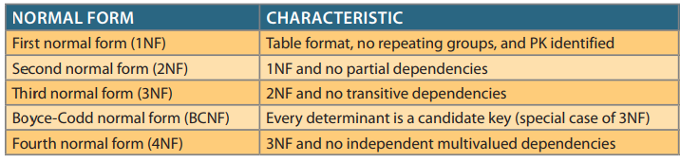
The most common normal forms
www.its.ac.id
INSTITUT TEKNOLOGI SEPULUH NOPEMBER, Surabaya - Indonesia

Slide 10
Normalization
The normalization start with identifying the dependencies on the relation (table) and normalizing the ralation
After that breaking up the relation (table) into a set of new relations (tables) based on the identified dependencies
www.its.ac.id
INSTITUT TEKNOLOGI SEPULUH NOPEMBER, Surabaya - Indonesia

Slide 11
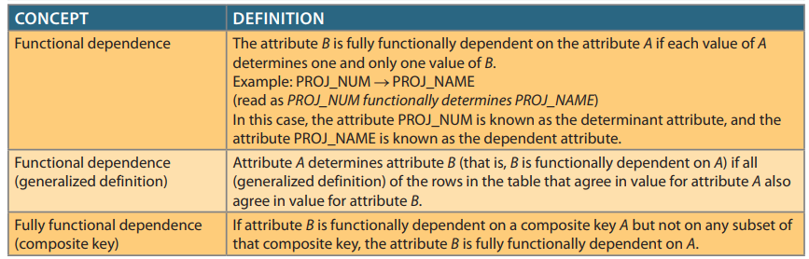
Functional Dependence Concepts
www.its.ac.id
INSTITUT TEKNOLOGI SEPULUH NOPEMBER, Surabaya - Indonesia

Slide 12
Functional dependencies
Two type of functional dependencies:
Partial dependencies When the attribute is dependent on only a subset of the primary key
Transitive dependencies An attribute is dependent on another attribute that is not part of the primary key
More difficult to identify among a set of data
www.its.ac.id
INSTITUT TEKNOLOGI SEPULUH NOPEMBER, Surabaya - Indonesia

Slide 13
Conversion to first normal form (1NF)
From example in table 6.1 there is a repeating group (PROJ_NUM)
Repeating group derives from a group of multiple entries of the same or multiple types can exist for any single key attribute occurrence
1NF:
All of the key attributes are defined
There are no repeating group in the table
All attributes are dependent on the primary key (PK)
www.its.ac.id
INSTITUT TEKNOLOGI SEPULUH NOPEMBER, Surabaya - Indonesia

Slide 14
Conversion to first normal form (1NF)
Normalizing can be done by three steps:
Eliminate the repeating group and make sure each row only defines a single entity instance
Identify the primary key
Identify all dependencies
www.its.ac.id
INSTITUT TEKNOLOGI SEPULUH NOPEMBER, Surabaya - Indonesia

Slide 15
Step 1: Eliminate the repeating groups
Converting multivalued attribute into single-valued attribute
www.its.ac.id
INSTITUT TEKNOLOGI SEPULUH NOPEMBER, Surabaya - Indonesia

Slide 16
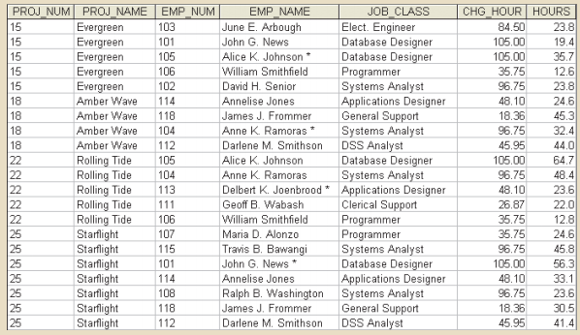
Step 1: Eliminate the repeating groups
www.its.ac.id
INSTITUT TEKNOLOGI SEPULUH NOPEMBER, Surabaya - Indonesia

Slide 17
Step 2: identify the primary key
From the table in step 1, there is not any unique value that can be used as primary key
In that case the primary key can be composed primary key from PROJ_NUM and EMP_NUM
www.its.ac.id
INSTITUT TEKNOLOGI SEPULUH NOPEMBER, Surabaya - Indonesia

Slide 18
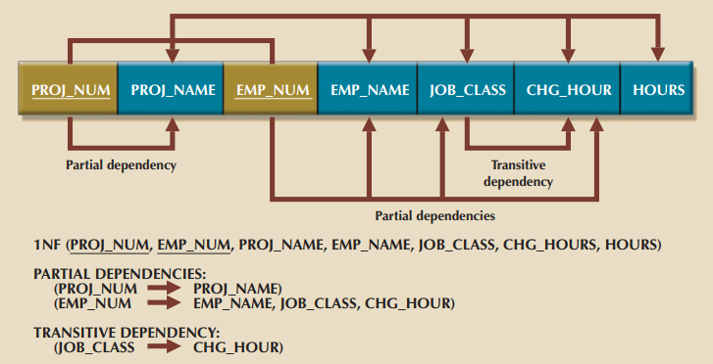
Step 3: Identify all dependencies
After identify the PK in step 2, we can get the dependency: (PROJ_NUM, EMP_NUM) → PROJ_NAME, EMP_NAME, JOB_CLASS, CHG_HOUR, HOURS
www.its.ac.id
INSTITUT TEKNOLOGI SEPULUH NOPEMBER, Surabaya - Indonesia

Slide 19
1NF
Now, the table from earlier example already satisfied the 1NF
But there are a problem:
Update anomalies
Modifying the JOB_CLASS for employee requires updating many entries
Otherwise it will generate data inconsistencies
Insertion anomalies
Adding a new employee requires the employee to be assigned to a project and enter duplicate project information
Deletion anomalies
Supposed only one employee is associated to a given project, if that employee is deleted the information of project will also be deleted
Such data anomalies violate the relational database’s integrity and consistency rules
www.its.ac.id
INSTITUT TEKNOLOGI SEPULUH NOPEMBER, Surabaya - Indonesia

Slide 20
Conversion to second normal form (2NF)
Conversion to 2NF only occurs when the 1 NF has composite PK
If the 1 NF has a single attribute PK, then the table is automatically in 2NF
The table is in 2NF if:
It is in 1NF
It includes no partial dependencies
Step by step conversion of 2NF from the result of 1NF:
Make new tables to eliminate partial dependencies
Reassign corresponding dependent attributes
www.its.ac.id
INSTITUT TEKNOLOGI SEPULUH NOPEMBER, Surabaya - Indonesia

Slide 21
Step 1: Make new tables to eliminate partial dependencies
For each component of primary key
Create a new table with a copy of that component as primary key
From composite primary key (PROJ_NUM, EMP_NUM):
We can create three new tables with below primary key:
PROJ_NUM
EMP_NUM
PROJ_NUM, EMP_NUM
www.its.ac.id
INSTITUT TEKNOLOGI SEPULUH NOPEMBER, Surabaya - Indonesia

Slide 22
Step 2: Reassign corresponding dependent attributes
Create appropriate table’s name:
PROJECT (PROJ_NUM, PROJ_NAME)
EMPLOYEE (EMP_NUM, EMP_NAME, JOB_CLASS, CHG_HOUR)
ASSIGNMENT (PROJ_NUM, EMP_NUM, ASSIGN_HOURS)
www.its.ac.id
INSTITUT TEKNOLOGI SEPULUH NOPEMBER, Surabaya - Indonesia

Slide 23
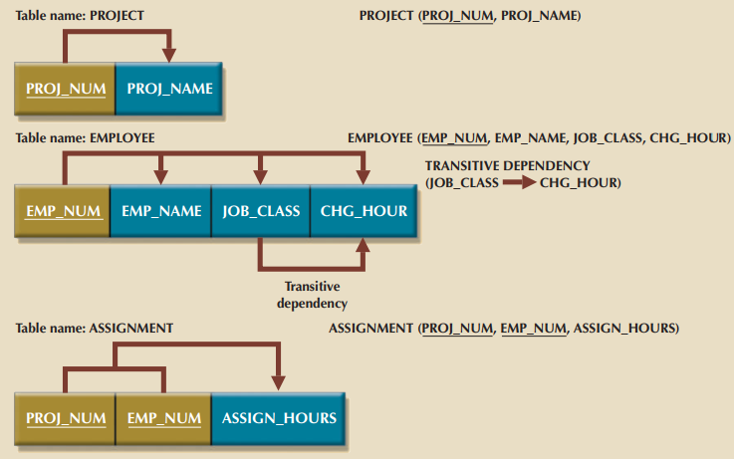
Step 2: Reassign corresponding dependent attributes
www.its.ac.id
INSTITUT TEKNOLOGI SEPULUH NOPEMBER, Surabaya - Indonesia

Slide 24
Conversion to third normal form (3NF)
From the result of 2NF, there is transitive dependency, which can generate anomalies
Example:
if the charge per hour changes for a job classification held by many employee
We have to update all of the record
If we forget to update some of the employee records, different employees with the same job description will generate different hourly charges
www.its.ac.id
INSTITUT TEKNOLOGI SEPULUH NOPEMBER, Surabaya - Indonesia

Slide 25
Conversion to third normal form (3NF)
A table is satisfied the 3NF when:
It is 2NF
It contains no transitive dependencies
www.its.ac.id
INSTITUT TEKNOLOGI SEPULUH NOPEMBER, Surabaya - Indonesia

Slide 26
Conversion to third normal form (3NF)
Steps to convert to the 3NF:
Make new tables to eliminate transitive dependencies
For every transitive dependency, write a copy of its determinant as PK for new table
A determinant is any attribute whose value determines other values within a row
In this case the determinant for the transitive dependency is JOB_CLASS
Reassign corresponding dependent attributes
Identify the attributes that are dependent on each determinant
Place the dependent attributes in the new tables with their determinant
Remove them from the original tables
www.its.ac.id
INSTITUT TEKNOLOGI SEPULUH NOPEMBER, Surabaya - Indonesia

Slide 27
Conversion to third normal form (3NF)
After 3NF is completed the database will contained four tables:
PROJECT (PROJ_NUM, PROJ_NAME)
EMPLOYEE (EMP_NUM, EMP_NAME, JOB_CLASS)
JOB (JOB_CLASS, CHG_HOUR)
ASSIGNMENT (PROJ_NUM, EMP_NUM, ASSIGN_HOURS)
www.its.ac.id
INSTITUT TEKNOLOGI SEPULUH NOPEMBER, Surabaya - Indonesia

Slide 28
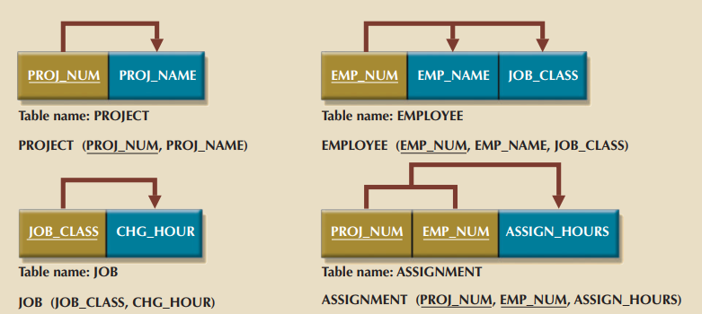
3NF
www.its.ac.id
INSTITUT TEKNOLOGI SEPULUH NOPEMBER, Surabaya - Indonesia

Slide 29
Improving the design
Evaluate PK assignment
In table EMPLOYEE there is attribute JOB_CLASS, means each time new employee entered we have to add JOB_CLASS that prone to error (referential integrity violations)
Why?
Because the user can enter different name with refer to the same value
Example: DB engineer == Database Engineer
How to resolve this?
www.its.ac.id
INSTITUT TEKNOLOGI SEPULUH NOPEMBER, Surabaya - Indonesia

Slide 30
Improving the design cont.
Using JOB_CODE rather than JOB_CLASS
So that in table JOB we create an attribute as primary key with name JOB_CODE
JOB_CODE → JOB_CLASS, CHG_HOUR
JOB (JOB_CODE, JOB_CLASS, CHG_HOUR)
Note: the JOB_CLASS and CHG_HOUR is not transitive dependency, since JOB_CLASS is a candidate key
www.its.ac.id
INSTITUT TEKNOLOGI SEPULUH NOPEMBER, Surabaya - Indonesia

Slide 31
Improving the design cont.
Evaluate naming conventions
As the previous class, naming convention increase the understandability to read the relation
In this case we can change the CHG_HOURS into JOB_CHG_HOURS
So that we know that CHG_HOURS is associate with table JOB
Refine attribute atomicity
Attribute atomicity rule means that the attribute cannot be further subdivided into meaningful value
Example: in EMPLOYEE, EMP_NAME can be changed into EMP_LNAME and EMP_FNAME
www.its.ac.id
INSTITUT TEKNOLOGI SEPULUH NOPEMBER, Surabaya - Indonesia

Slide 32
Improving the design cont.
Identify new attributes
If the entity were used in real-world environment, several attribute would have to be added
In table EMPLOYEE, we can add attributes such as employee hire date, employee date of birth etc.
Identify new relationships
In this case the users need to track which employee is acting as the manager of each project
This can be implemented as relationship between EMPLOYEE and PROJECT
We can add EMP_NUM as FK in PROJECT
www.its.ac.id
INSTITUT TEKNOLOGI SEPULUH NOPEMBER, Surabaya - Indonesia

Slide 33
To be continue…
www.its.ac.id
INSTITUT TEKNOLOGI SEPULUH NOPEMBER, Surabaya - Indonesia

Slide 34
Exercise
In a group of 3
Convert this ERD into dependency diagram that is at least in 3NF
Give the explanation for each stage (1NF, 2NF, 3NF)
www.its.ac.id
INSTITUT TEKNOLOGI SEPULUH NOPEMBER, Surabaya - Indonesia

Slide 35
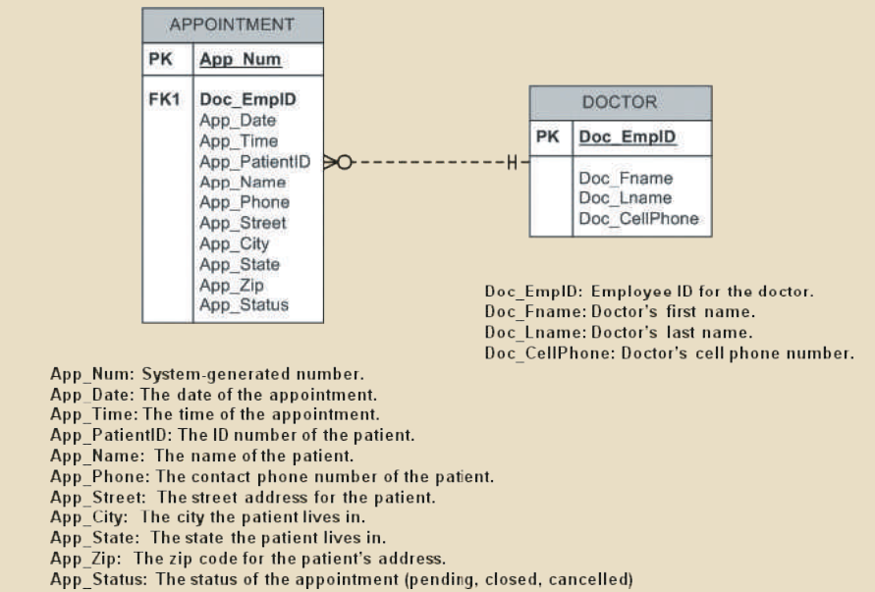
Exercise
www.its.ac.id
INSTITUT TEKNOLOGI SEPULUH NOPEMBER, Surabaya - Indonesia

Slide 36
Thank you

